Slide 1
Performance 2: Latency Simulation & Throughput
Source of most materials:
Xiwei Xu, Ingo Weber, and Mark Staples. Architecture for Blockchain Applications. Springer, 2019

Slide 2
What will you learn this week?
Performance Overview
Latency
Transaction Inclusion in Public Blockchain
Simulating Latency
Throughput

Slide 3
Simulating Latency

Slide 4
An Example (like in the Cost examples): Process Execution on Public Blockchain
(First Activity)
(Fast Automated Response)
(Slow or Manual Response)
…
A process instance can be represented as a smart contract on a blockchain.
Each activity in the process can be a different function in the smart contract API.
An off-chain “trigger component” on a cloud or enterprise server watches a blockchain node and invokes the next activity in the process
If activity is automated: fast; otherwise: slow(er) e.g. in response to some manual activity
Notes:
our research group studied the possibility of using blockchain for collaborative business process in order to address the lack of trust problem in collaborative business process.
The idea is to use blockchain and the smart contract functionality to enforce the trustworthiness of the process without having a centralized trusted third party.
In the proposed method, blockchain facilitates collaborative process either of two ways; as a choreography monitor which stores the process execution status and provides immutable data storage or active mediator by coordinating the collaborative process.
smart contracts in a blockchain can not interact directly with the external world, a trigger component connects the processes executing on blockchain to enterprise systems by acting as an agent for an organization. The trigger manages keys, keeps track of the data payload in API calls, and can interact with external services including other databases or web services.
Generally each organization has to deploy it’s own trigger and at least one blockchain full node connected to the blockchain.

Slide 5
Latency of Process Execution on Public Blockchain
Here, the design does not use confirmation blocks.
Quick & dirty!
Assumes averages (median or mean)!
Transactions arrive in the middle of an interblock time window
Uniform average interblock time
1.5 x interblock
+ 2 x interblock
+ activity duration + 1.5 x interblock
(First Activity)
(Fast Automated Response)
(Slow or Manual Response)
…
The first activity will arrive in “the middle” of some interblock time window, so takes 1.5 x interblock times.
If activity response is very fast (in the same interblock time window), it will still be too late to include in the next block, so will take 2 interblock times.
If the activity response is slow (longer than the interblock time window), it will arrive in “the middle” of some future interblock time window
Notes:
our research group studied the possibility of using blockchain for collaborative business process in order to address the lack of trust problem in collaborative business process.
The idea is to use blockchain and the smart contract functionality to enforce the trustworthiness of the process without having a centralized trusted third party.
In the proposed method, blockchain facilitates collaborative process either of two ways; as a choreography monitor which stores the process execution status and provides immutable data storage or active mediator by coordinating the collaborative process.
smart contracts in a blockchain can not interact directly with the external world, a trigger component connects the processes executing on blockchain to enterprise systems by acting as an agent for an organization. The trigger manages keys, keeps track of the data payload in API calls, and can interact with external services including other databases or web services.
Generally each organization has to deploy it’s own trigger and at least one blockchain full node connected to the blockchain.

Slide 6



Student Task
How would application-level latency be impacted by using 3 confirmation blocks?

Slide 7
Simulation for Latency Estimation
e.g. using Palladio
Open source, Component-Based
https://www.palladio-simulator.com/home/
Widely used for performance modelling and simulating
UML-like notation
Need to Benchmark Transaction Inclusion on Blockchain
Treat the blockchain as a black box – Txs in / Txs or effects out
Measure time between submitting a transaction and receiving verification by a given number of confirmation blocks
Not just averages; measure the distribution of times
Also benchmark trigger implementation that invokes Txs
“Predicting latency of blockchain-based systems using architectural modelling and simulation” https://research.csiro.au/data61/wp-content/uploads/sites/85/2016/08/2017-ICSA-Blockchain-Latency-Sim-authors_copy.pdf
Notes:
We used palladio component model for modelling. Palladio has been used and studied in the literature thoroughly about the accuracy and the capability of modelling different kind of systems. We shows a methodology to use palladio component model for predicting blockchain based system performance.
We used existing methods so that the non blockchain components can be modelled as it is using existing methods while we suggest how to model the latency of blockchain based components.
For this paper, we used Ethereum as the blockchain and we set up a private blockchains for different configurations. Then we benchmarked the blockchain for obtaining the parameters need to construct palladio models.

Slide 8
Simulation for Predicting Latency
Architecture
Model Construction
Simulation
Micro Benchmarking
Notes:
So we benchmarked the properties of blockchain and constructed performance models and used constructed models for predicting system level latencies and to compare the latency impact to the overall system incur by introducing blockchain to the system.

Slide 9
Benchmarking Transaction Commit Time
Transaction Inclusion Time: Time Taken from Submitting transaction until transaction gets included in blockchain
Notes:
A key parameter for our architectural performance model is the transaction commit time: the time taken from submitting a transaction until we have sufficient confidence that the transaction has been successfully included in the blockchain.
We start the clock on submission of a transaction, and stop the clock when the broadcasting node receives a sufficient number of confirmation blocks after receiving a block which includes the transaction.

Slide 10
Example Business Process: Incident Management
Notes:
To evaluate our models, we implemented the business process shown here using blockchain as a mediator for managing process. There is a resolution rate at every stage and it not resolve the issue at that stage passed to the next stage so on.

Slide 11
Example Usage Model
Usage diagram
Notes:
We constructed palladio models accordingly. We injected measurement to constructed models as probability distribution functions gathered. Here I have show here the usage diagram which defines the business process execution flow. You can find model construction in detail in our paper.

Slide 12
Example Results & Checking vs. Real System
 | Measured | Simulated | Relative error
Median latency | 136s | 134s | 1.6%
Standard error of median (SEM) | 1.27 | 1.07 | -
95th Percentile | 274s | 248s | 9.4%
99th Percentile | 373s | 329 | 11.5%
Notes:
So, We simulated the models and compare the simulated results with the actual implementation. Here you can see the measured and simulated system level latencies. We gathered 1000 samples for each and we were able to achieve good results. Relative error of median was 1.6% for this experiment. For defining latencies, as this is a long tail distribution, 95% and 99 percentiles are also important and we were able to achieve 9.4% and 11.5% for those measures accordingly.

Slide 13
Throughput

Slide 14

Throughput
How many transactions can you process in a unit of time?
e.g. Visa card processing, 2000 tps daily average, max. tested capacity ~50,000 tps
https://www.visa.com/blogarchives/us/2013/10/10/stress-test-prepares-visanet-for-the-most-wonderful-time-of-the-year/index.html
Bitcoin has poor throughput capacity (3 to 7 tps)
Ethereum has poor throughput capacity (7 to 25 tps)
https://medium.com/coinmonks/understanding-cryptocurrency-transaction-speeds-f9731fd93cb3
You as an individual user are unlikely to create system overload!
But you need to understand trends in ecosystem utilisation and bottlenecks
e.g. at one point in time, about a third of transactions on Ethereum were for cryptokitties

Slide 15
Throughput Limits
Transactions per block * blocks per second = Transactions per second
Bitcoin limited by block size and average transaction size
1000000 Bytes / 495 Bytes / 600 seconds = 3.37 tps
(growth in use of segwit and other Tx size optimisation can roughly double throughput)
Ethereum limited by block gas limits, and average transaction gas
~10,000,000 gas block limit / 57,500 gas / 15 seconds = 11.6 tps
(Based on data from 17 Dec 2019; using Google BigQuery Ethereum dataset https://cloud.google.com/blog/products/data-analytics/ethereum-bigquery-public-dataset-smart-contract-analytics )
Limits are there mainly to control block propagation times
To control likelihood of uncles, DDoS, and control centralisation of mining

Slide 16
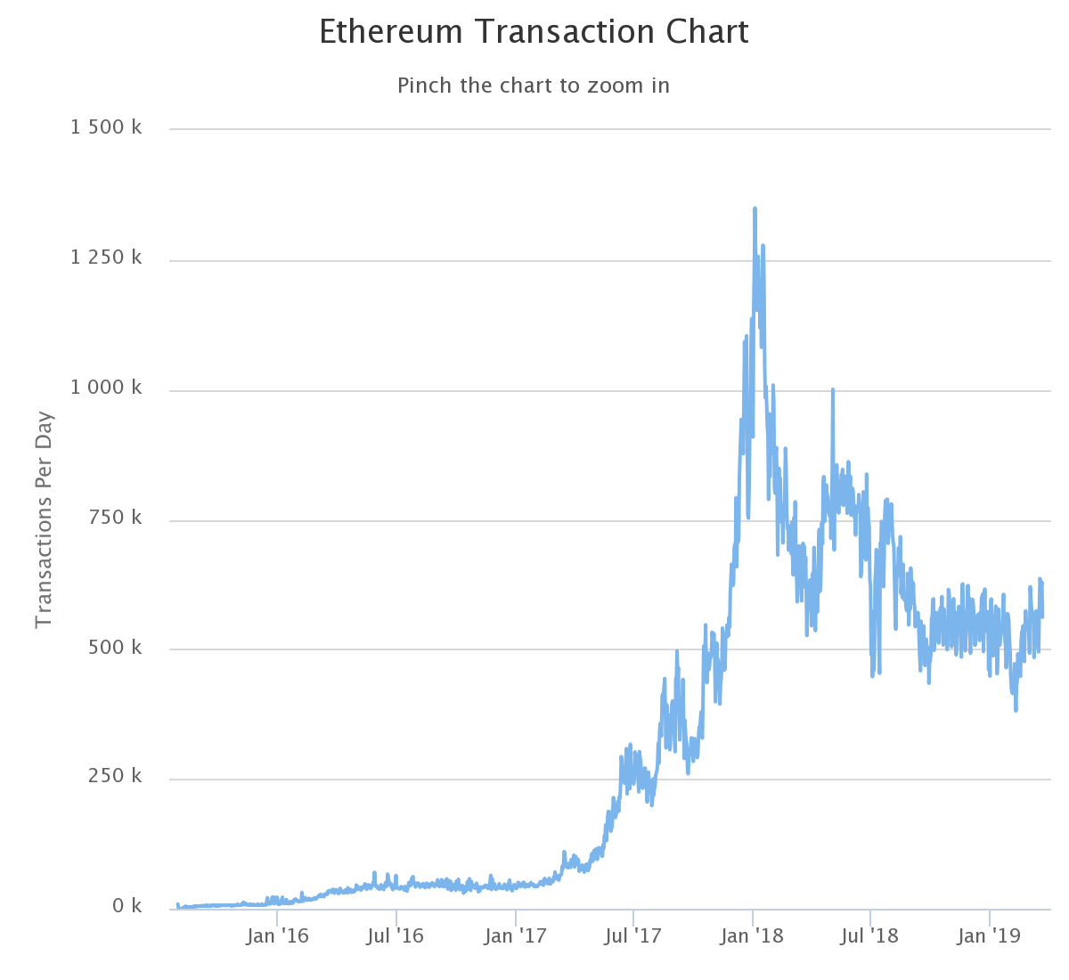
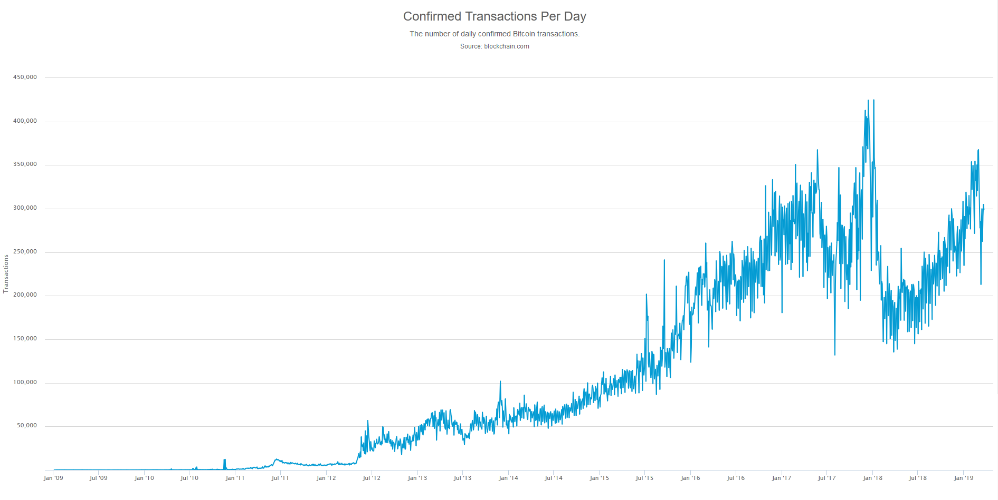


Growth in Throughput
3.3 tps
10 tps

Slide 17
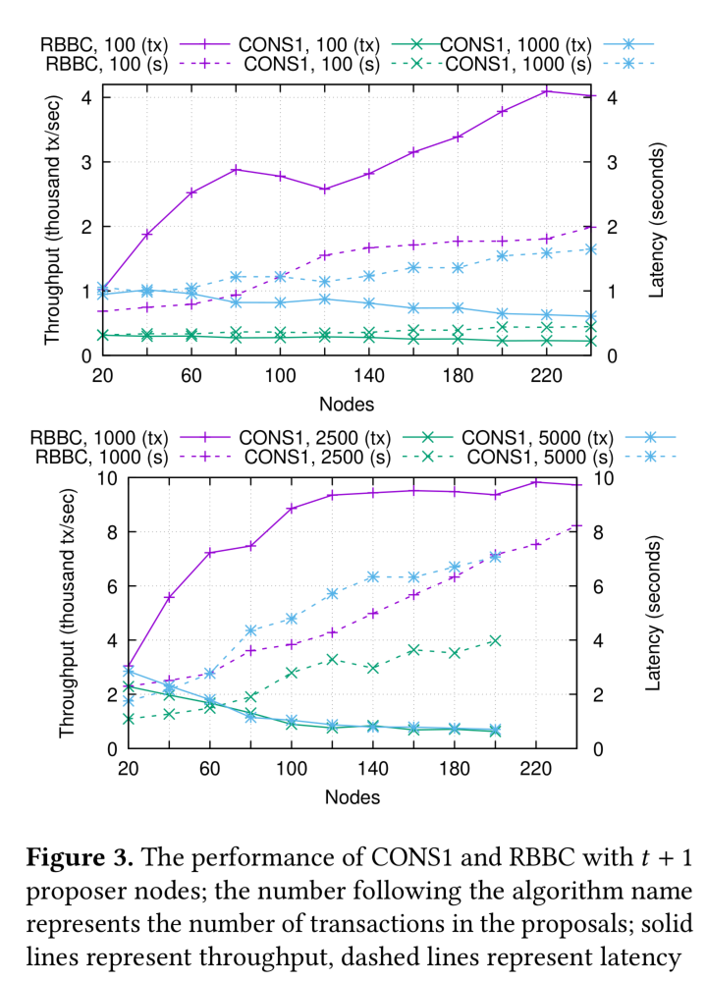
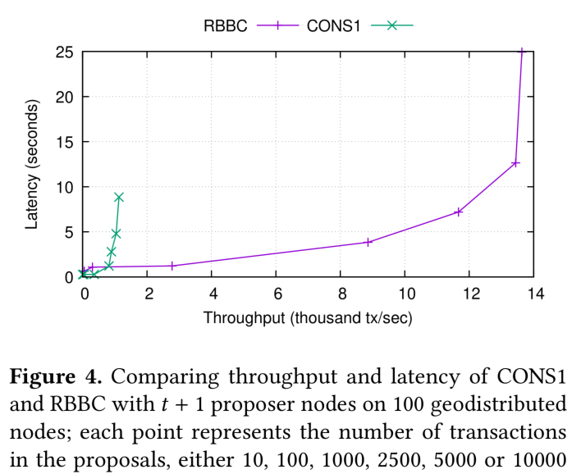
Red Belly Blockchain Throughput
“Evaluating the Red Belly Blockchain”
http://arxiv.org/abs/1812.11747

Slide 18
DAGs, Sharding, etc
Blockchains enforce a strictly ordered single list of transactions
Critical for integrity of transfer of digital assets (no “double spending”)
But creates a throughput bottleneck
DAGs (“tangles”), e.g., IOTA, …
Not a list, but a directed acyclic graph
Multiple heads (“tips”), each processed mostly concurrently, repeatedly diverging/merging
Hard to maintain data integrity across the heads – transactions can conflict!
Can, e.g. resolve a bit like like Nakamoto consensus – tentatively included until merged
Sharding, e.g. future Ethereum?
Split chain into smaller chunks (horizontal partitioning), each processed mostly concurrently
Might increase Ethereum throughput by 1000x
Hard to maintain data integrity across the shards
Shards interact with a protocol only when necessary, to maintain global integrity
Networks or hierarchies of interrelated blockchains
e.g. geographically-sharded IoT blockchain networks

Slide 19
Student Task
How can architects influence throughput?

Slide 20
How Application Architects Can Influence Transaction Throughput
Use another blockchain (private? or a public blockchain that works “better”?)
Configure blockchain to use other consensus algorithms (PBFT, PoA, …)
Sharding, DAGs
Configure blockchain to use a larger block size, or smaller interblock time
Sidechains, channels
If you don’t need exchange of digital property, consider networks of blockchains, DAGs, …
If you have to use a specific public blockchain, then focus on how you use the blockchain, and focus on other areas of the application architecture
Reduce the data you put on-chain (sampling, digests, hashes, …)
Do more work off-chain, e.g. using “state channel” design pattern, to be discussed in later lectures

Slide 21
Summary

Slide 22
Summary: General
(Load × Resources) → System → (Performance × Resource Utilisation)
Measurement is critical to understand all this in practice
Kinds of Performance: Latency vs Throughput (vs Timeliness)
Blockchains have high latency and high variability of latency
Variability is significantly affected by choice of consensus mechanism
Number of confirmation blocks are a risk-based decision
Can avoid them if you don’t use Nakamoto consensus/probabilistic commits
Many Blockchains have poor throughput
Affected by ledger structure and consensus mechanism
Do you need exchange of digital assets?
If you don’t need a global integrity property, you can avoid major bottlenecks

Slide 23
Summary: Predicting Latency
For a single transaction on public blockchain latency = 1.5 * interblock time
Assuming transaction is included in next possible block
Ignoring transaction / block propagation times
On average (ignoring variation in interblock time, arrival time)
For sequence of n > 1 transactions on public blockchain latency = 1.5 * interblock time + (n-1)*2 interblock time
Assuming next transaction is injected immediately into the interblock window
Can use simulation for more precise prediction of application-level latency
Can explore latency variation, interactions between components, and bottlenecks
Or, use measurement and test of real(istic) system under real(istic) load

Slide 24
Performance 2: Latency Simulation & Throughput
Source of most materials:
Xiwei Xu, Ingo Weber, and Mark Staples. Architecture for Blockchain Applications. Springer, 2019

